Slide 1
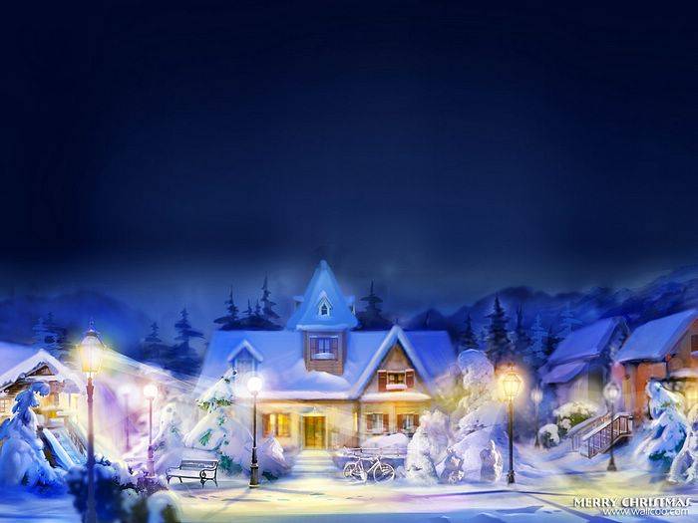
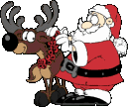
Present Continuous

Slide 2
New words
To deliver to sing
presents elf
a reindeer to play

Slide 3
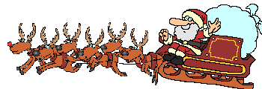
RULE

Slide 4
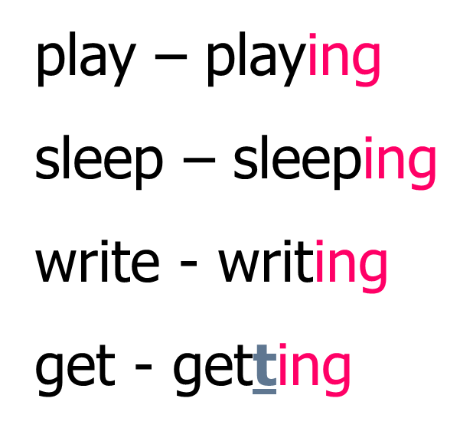
Remember
I am
He is
She is
It is Ving
We are
You are
They are

Slide 5
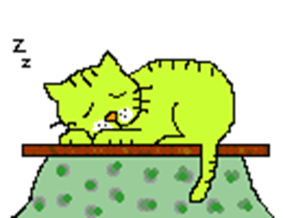
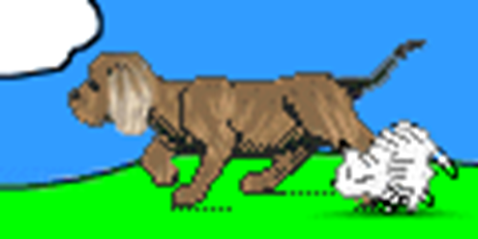

Slide 6
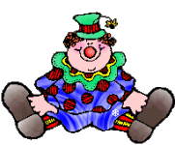
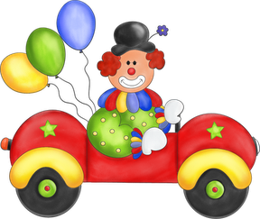
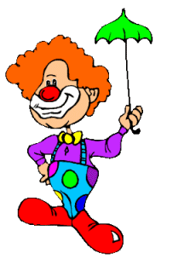
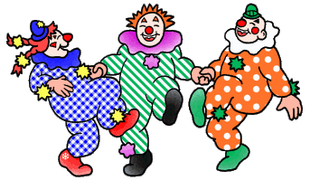
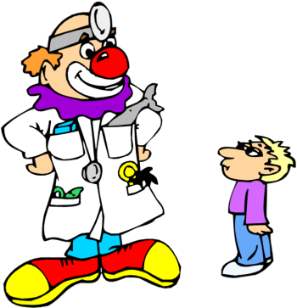
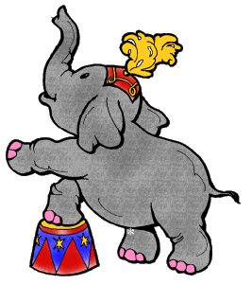
To be
he
am
is
are
he
you
we

Slide 7
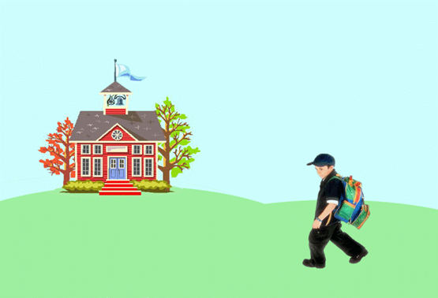
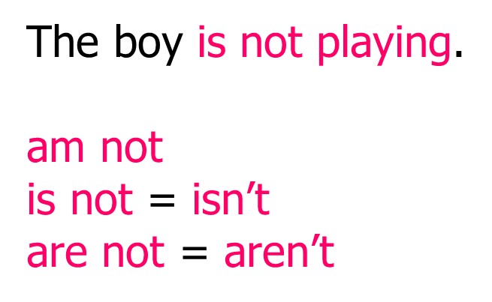

Slide 8
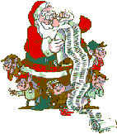
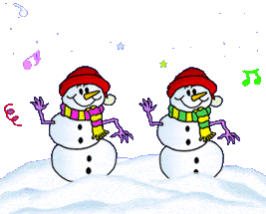
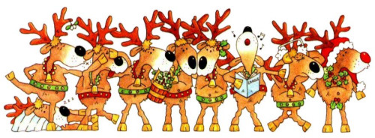
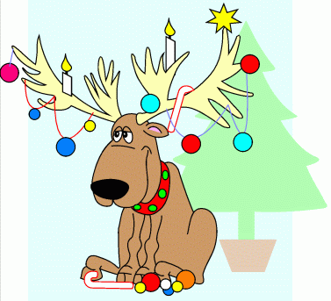
READING
DANCING
SINGING

Slide 9
MIMING GAME

Slide 10
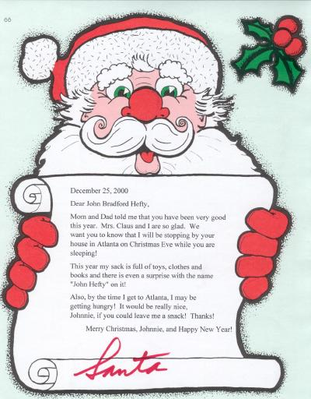
LETTER
TO
SANTA

Slide 11
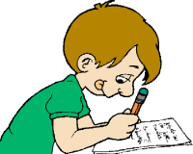
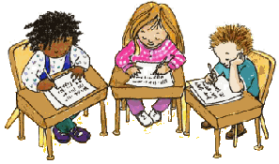
Hello Dear Santa!
My name is Alex. I am 8.
What are you doing now? you the letters?
I this letter to you.
Look! I to school with my mum. These are my
We to the teacher.
We in our copy-books. I like my school!
I am a good boy. Look! I my mum.
Can I have a for Christmas? With love,
Alex.

Slide 12
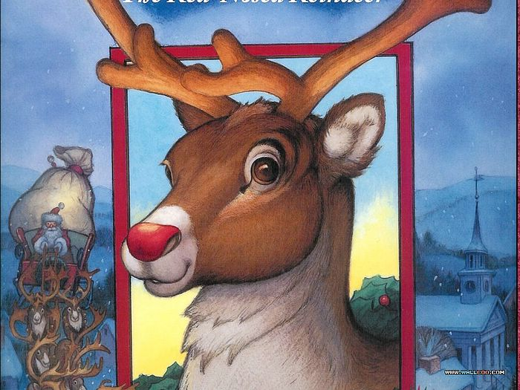

Slide 13
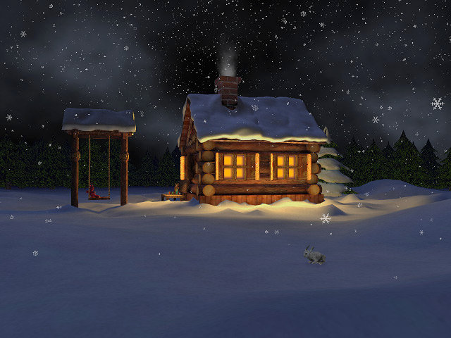
It is winter at the North Pole. It is snowing.

Slide 14
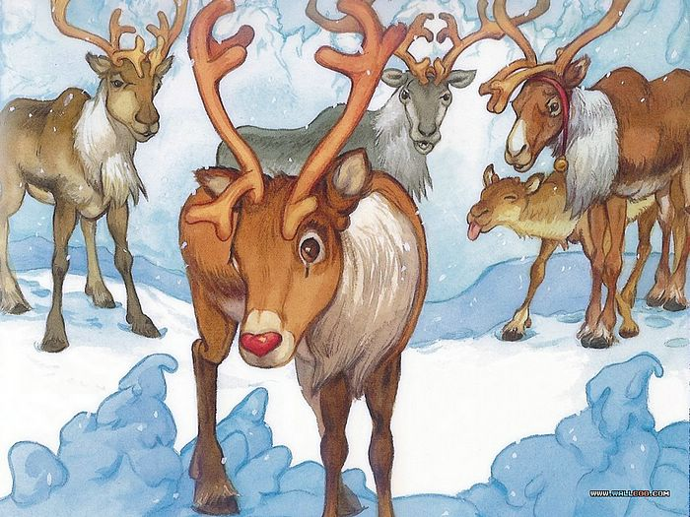
This reindeer is Rudolph. He is little and his antlers are little, too. He has a big red nose. His nose is shining.
Look! Those are reindeer. They have big antlers.

Slide 15
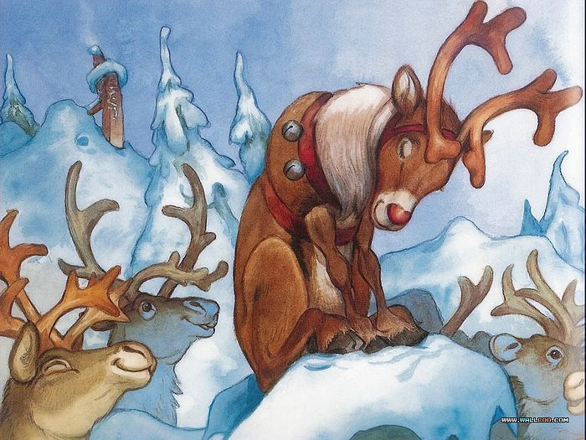
The reindeer are laughing at Rudolph.

Slide 16
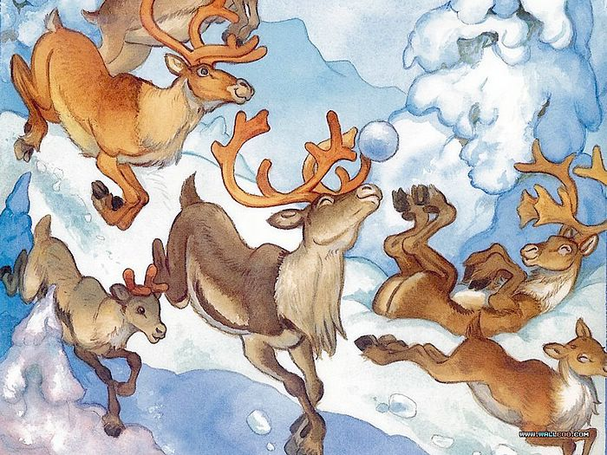
They are throwing snowballs at him and shouting: “Red-nose! Red-nose!”

Slide 17
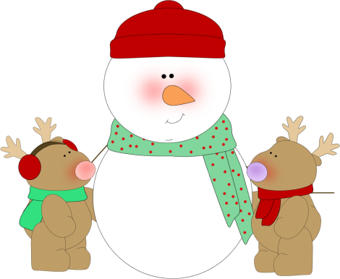
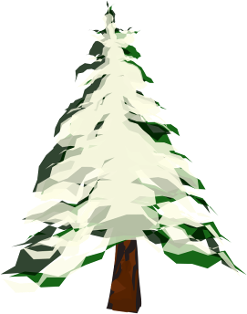
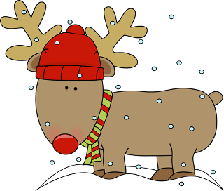
The reindeer love winter and snow. They are playing with the snow. They are making a snowman.
Rudolph isn’t playing with them. He is standing behind the tree and watching them.

Slide 18
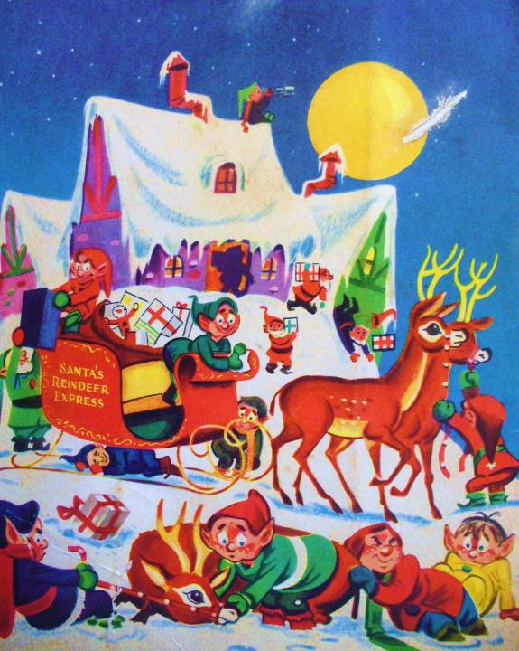
Christmas is coming!
The reindeer are happy.
They are helping Santa and his elves.

Slide 19
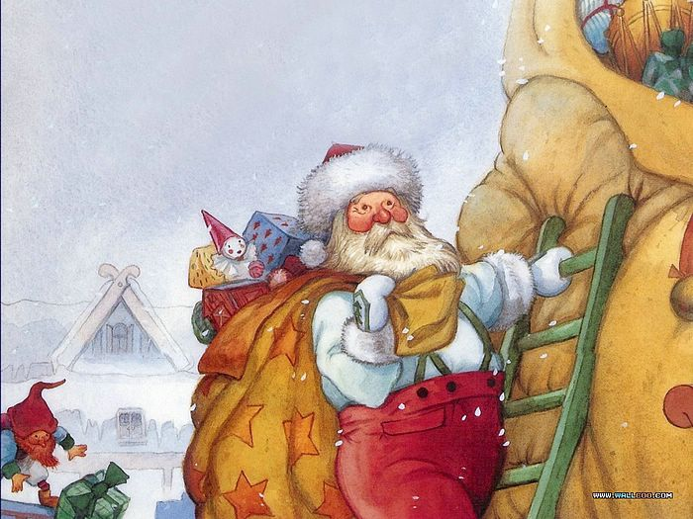
It’s Christmas Eve. It’s time to go!

Slide 20
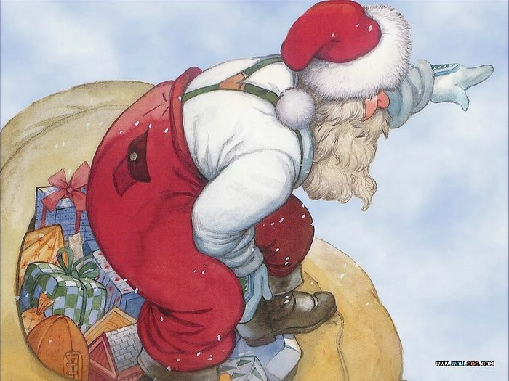
It’s very dark.
“Where is my Christmas list?”

Slide 21
But what is that? The red light is shining brightly. Closer. Closer. Look! It’s Rudolph’s red nose!

Slide 22
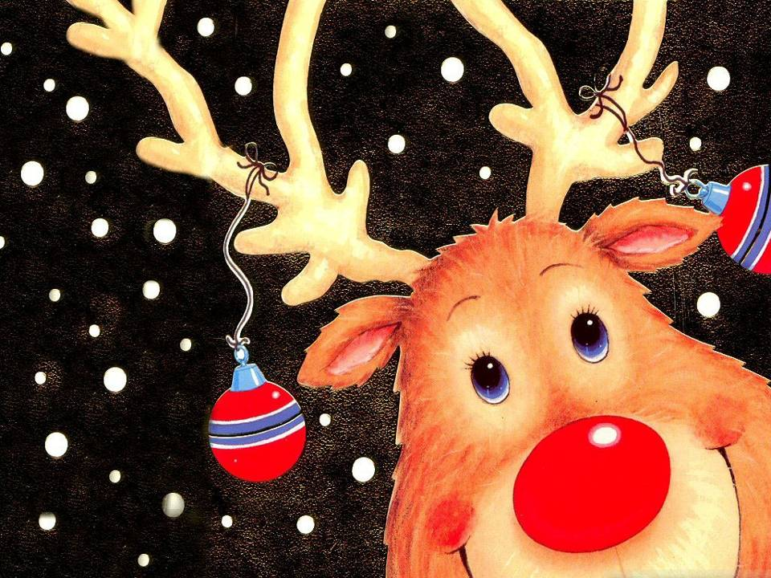
“Thank you Rudolph!”

Slide 23
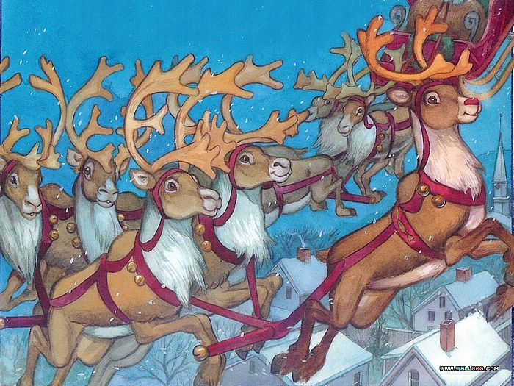
Santa is delivering the presents to the children. His reindeer are running very fast.
And Rudolph is the main reindeer. His nose is shining brightly in the sky. Can you see it?

Slide 24
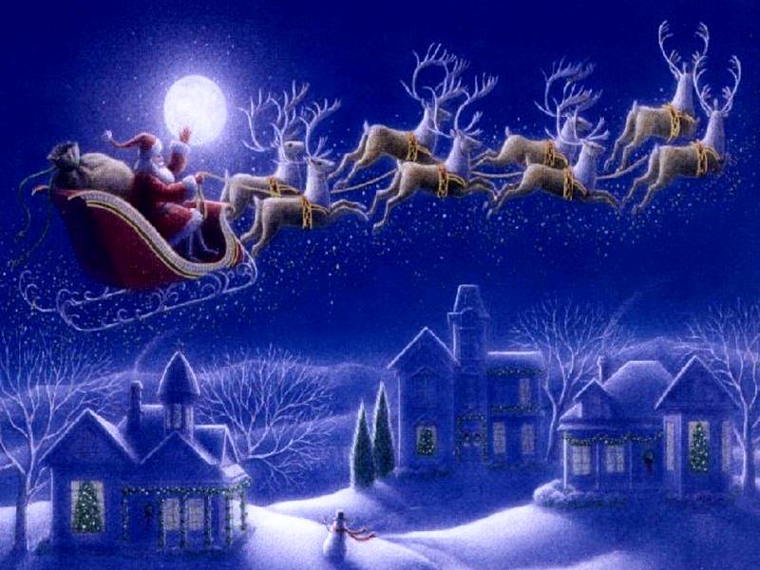

Slide 25
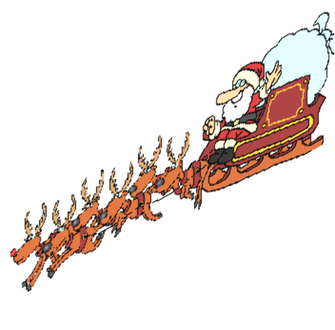
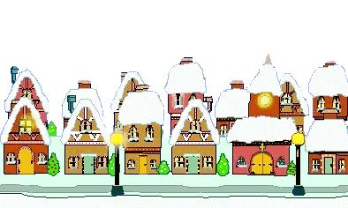
PHOTOS

